Slide 1
ARTEMIS
Λ
NASA’s campaign
ARTEMIS

Slide 2
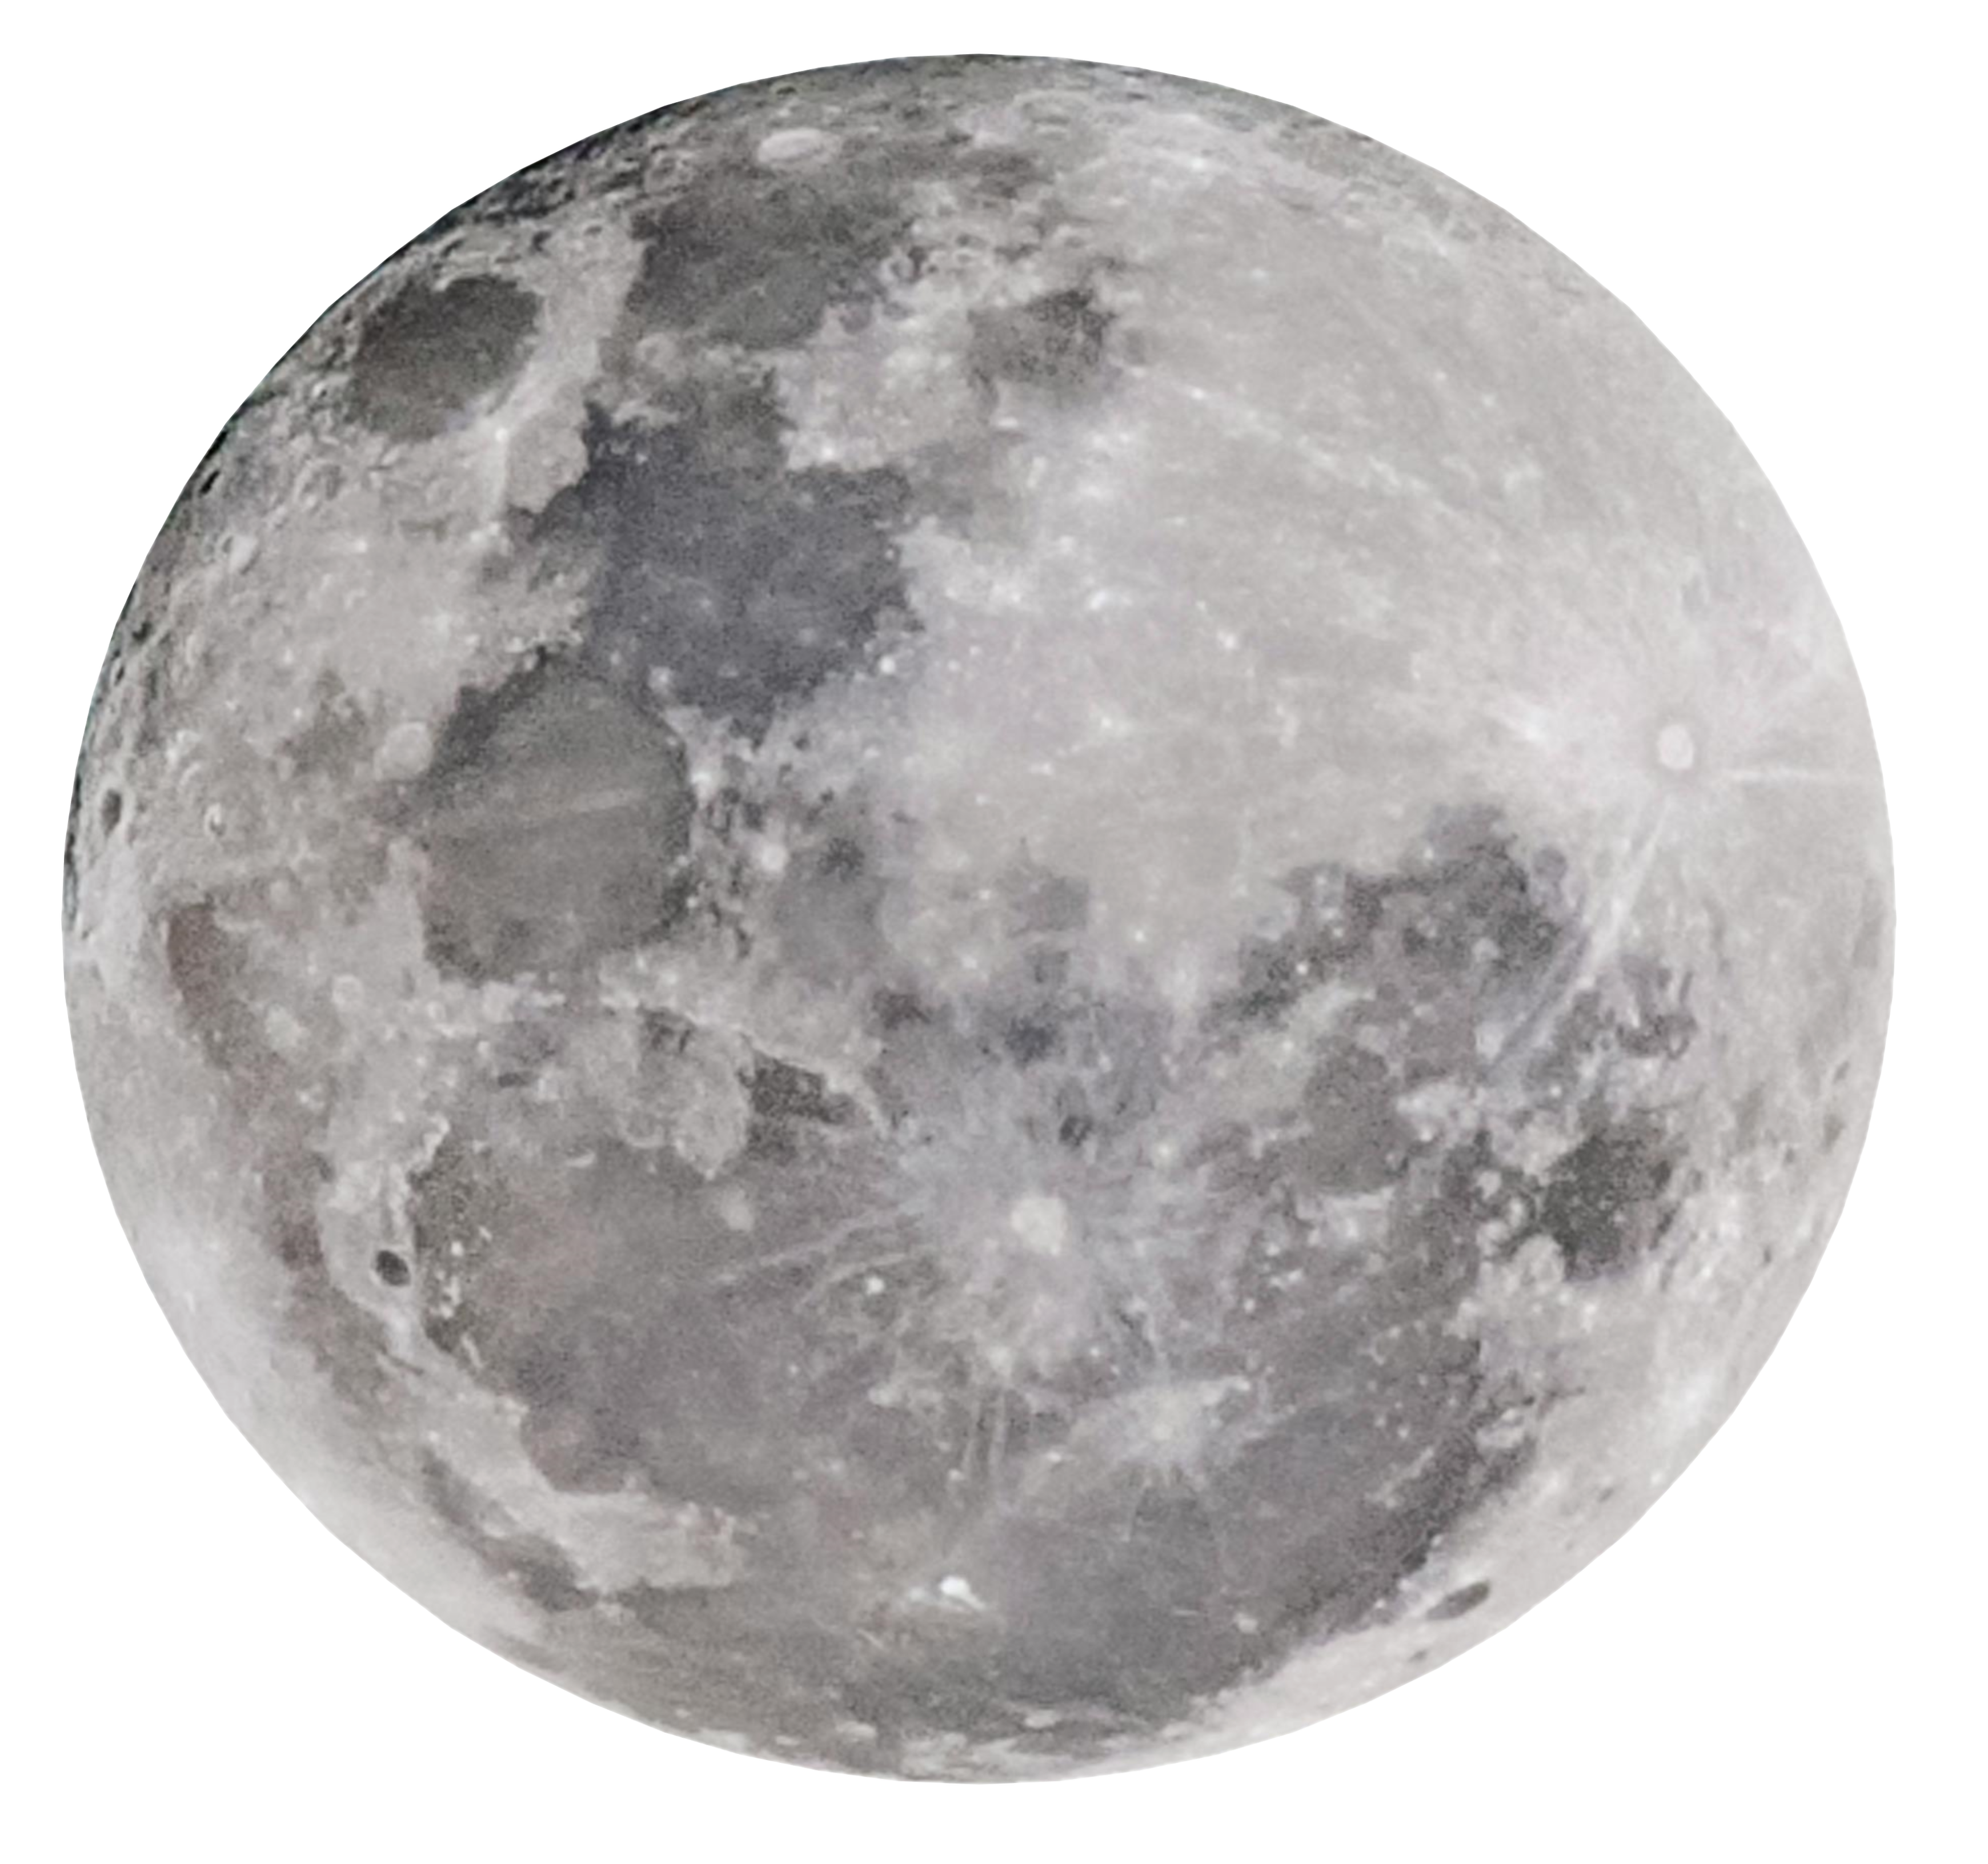
The Moon is a 4.5-billion-year-old time capsule
Λ
ARTEMIS

Slide 3
More about Artemis Missions
ARTEMIS I
ARTEMIS II
ARTEMIS III
was an uncrewed flight test of the Space Launch System and the Orion spacecraft around the Moon.
will be the first crewed flight test of the Space Launch System and the Orion spacecraft around the Moon.
will send the first humans to explore the region near the lunar South Pole.
Λ
ARTEMIS

Slide 4
Why We Are Going To The Moon
We’re going back to the Moon for scientific discovery, economic benefits, and inspiration for a new generation of explorers: the Artemis Generation.
With Artemis, we’re building on more than 50 years of exploration experience to reignite America’s passion for discovery.
1
Science & Discovery
Λ
ARTEMIS

Slide 5
We will explore more of the Moon than ever before with our commercial and international partners. Along the way, we will engage and inspire new audiences – we are the Artemis Generation.
2
Inspiration for a New Generation
Economic Opportunity
Artemis missions enable a growing lunar economy by fueling new industries, supporting job growth, and furthering the demand for a skilled workforce.
3
Λ
ARTEMIS

Slide 6
Exploration Systems
Space Launch System Rocket
Exploration Ground Systems
Orion Spacecraft
Human Landing System
Surface Mobility
Gateway
Λ
ARTEMIS

Slide 7
ARTEMIS I
ARTEMIS II
ARTEMIS III
100%
25%
0%
Mission completed
PLANNED
NOT PLANNED YET
DEC 11, 2022 12:00 UTC
LAUNCH: No earlier than Sept. 2025
FUTURE MISSION
Λ
ARTEMIS

Slide 8
Thanks for watching the presentation
All detailed information used in this presentation was taken from the official NASA webpage, located at https://www.nasa.gov/feature/artemis/.
Λ
ARTEMIS

